Slide 1


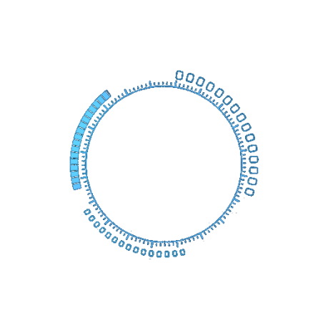

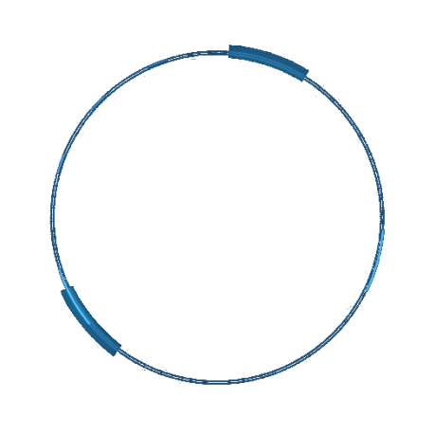
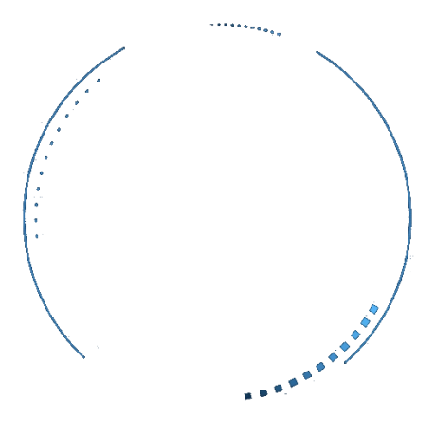
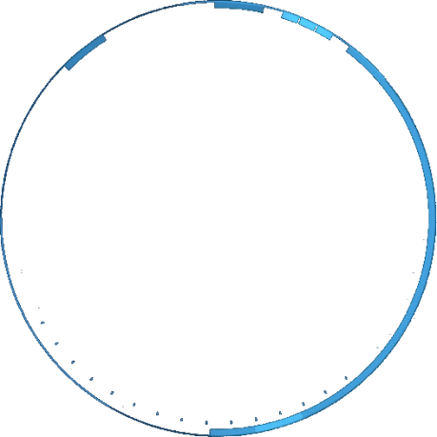


MathPix, Mendeley, Latex
By
Dr Rajesh Kumar

Slide 2
目录
Contents
Math Type
Mendeley
Latex
SnapChart
origin
02

Slide 3
How To use Install Latex
Install Miktex Complete Package (安装miktex完整软件包)
InsLyX-233-Installer (LYX-233-安装器)
install WinEdit (安装winedit)
Install Mendeley
Install MathType
Install mathpix
Install origin
Install grammarly
https://www.snapchart.co/main.html# (Edit Graphs)
https://apps.automeris.io/wpd/ (https://www.youtube.com/watch?v=P7GbGdMvopU) (Edit Graphs)
https://copyleaks.com/compare (compare Files)
https://www.onlinedoctranslator.com/en/translationform (Translate Complete File)
Quilt Bolt

Slide 4
Paper Ranking and Conference Ranking Check
Letpub Check SCI Journal Ranking http://www.letpub.com.cn/index.php?page=journalapp&fieldtag=all&firstletter=
Conference rank http://www.conferenceranks.com/?searchall=NLDB#
Engineering Village (Check EI Journal indexing) https://www.engineeringvillage.com/search/quick.url?CID=quickSearch&database=1
Clarative analytic JCR Ranking https://clarivate.com/
CCF https://www.ccf.org.cn/Academic_Evaluation/By_category/

Slide 5
Paraphrasing Websites
https://quillbot.com/app
https://free-article-spinner.com/

Slide 6
Paid Books Download in Free
https://zh.z-lib.org/
https://sci-hub.hkvisa.net/

Slide 7
Picture Editing Online
https://www2.lunapic.com/editor/
https://picto3d.com/

Slide 8
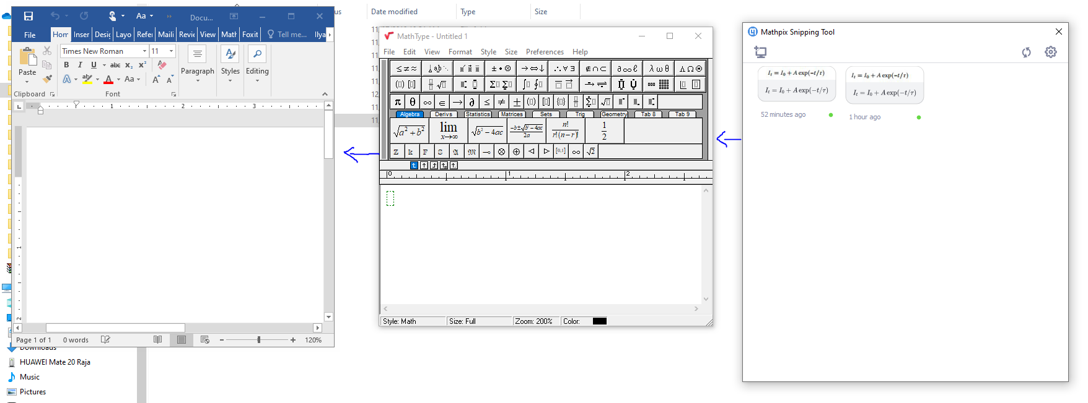
Math Type

Slide 9
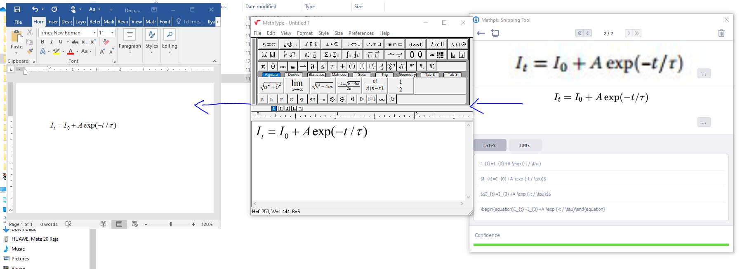
Math Type

Slide 10
What is Mendeley
Organize your documents + references
Collaborate by joining + creating groups
Discover statistics + recommendations
Stay up to date + learn more
Store your data
Manage your career
Notes:
This is a general overview of what we are going to cover in this presentation.
Let me start off with what is Mendeley. Is a research workflow tool and academic social network that helps you Organize your documents and references. Mendeley helps you collaborate with your fellow researchers online by joining and working together in groups. I’ll also show you how Mendeley can provide you with readership statistics and recommendations that help you stay up to date and learn more. Finally we’ll cover how Mendeley can help you securely store datasets so they can be cited and shared.

Slide 11
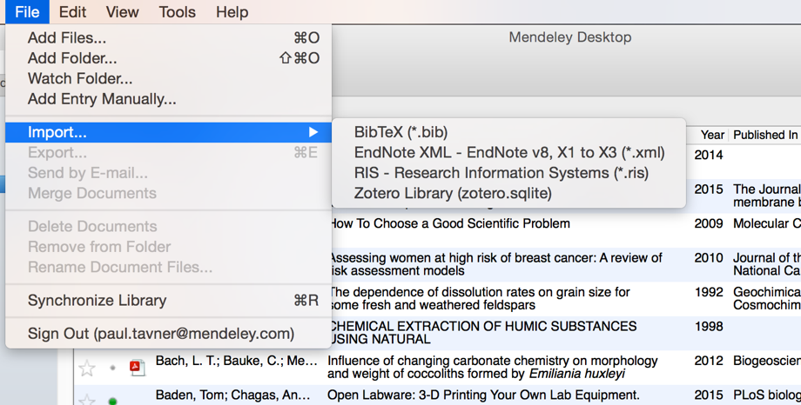
Adding Documents
Select a file or folder to
add from your computer
Import from another reference
manager, or BibTeX
Watch a folder
Add reference by
manually entering details
Notes:
Mendeley makes it easy to add documents. The simplest way is drag and drop the file right into Mendeley. There are actually quite a few ways to add documents to your library besides drag and drop you can use the File menu and select from a few options:
- You can select the file or a folder to add from your computer,
our you can define a watch folder. A watch folder is a folder or multiple folders that you define in your computer to keep an eye on. What this means is what whenever a pdf is added to your folder, Mendeley will automatically know is new and import it for you.
You can also add references manually instead, which allow you to complete a number of fields manually.
If you are already using another reference Manger such as RefWorks, EndNote or Zotero, you can also easily carry across your references to Mendeley easily. Simply export your library from those tools to a standard format sur RIS or BibTeX and you will have no problem importing your library.

Slide 12
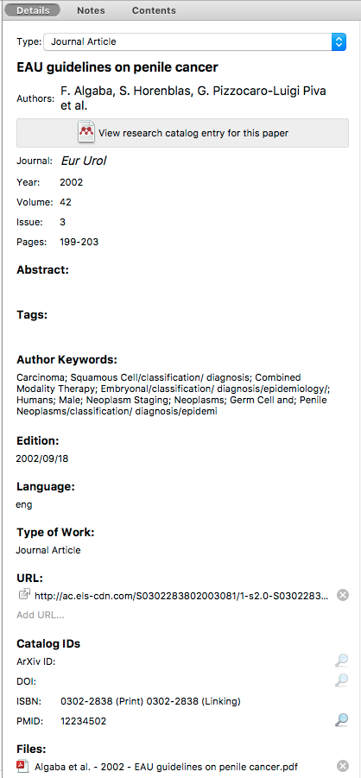
Document Details Lookup
Enter the DOI, PubMed or ArXiv ID and click on the magnifying glass to start lookup
Notes:
Keeping your document details clean and complete is super important. Therefore, I thought it would be a good idea to see how Mendeley takes care of most of the hard work for you. When you add a document to your library Mendeley will do it’s best to import all the relevant information from the article you just added but sometimes the data will be missing. Fortunately this is easy to fix. Enter the DOI, PubMed or ArXiv ID and click on the magnifying glass to have Mendeley perform an online search for the correct information. Mendeley will then add the correct information automatically for you. Sometimes Mendeley will flag the document for review which means some of the information may be missing or incomplete. At this point you can select to have Mendeley search for the document details using Google Scholar to fill in the missing fields. Keep in mind that you can always edit this fields manually at any time and if you make any mistakes simply undo the changes.

Slide 13


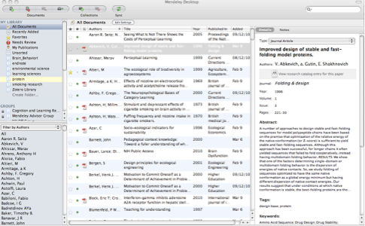
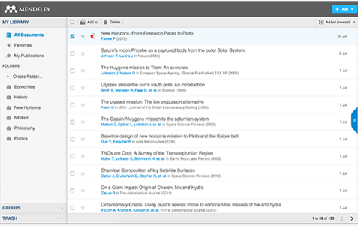

What is Mendeley?
Academic Software
Cross-Platform (Win/Mac/Linux/Mobile)
All Major Browsers
Desktop
Web
Mobile
Notes:
So what is Mendeley? Mendeley is an academic software which is available across a number of different platforms. You can run Mendeley on you’re your mac your pc or even on Linux and in all major browsers. Mendeley offers a desktop application that you can run in your computer a web library for whenever you are not at your computer and a mobile application so you can work on the go
We’ll see how the desktop and web components work together in the next couple of slides.

Slide 14
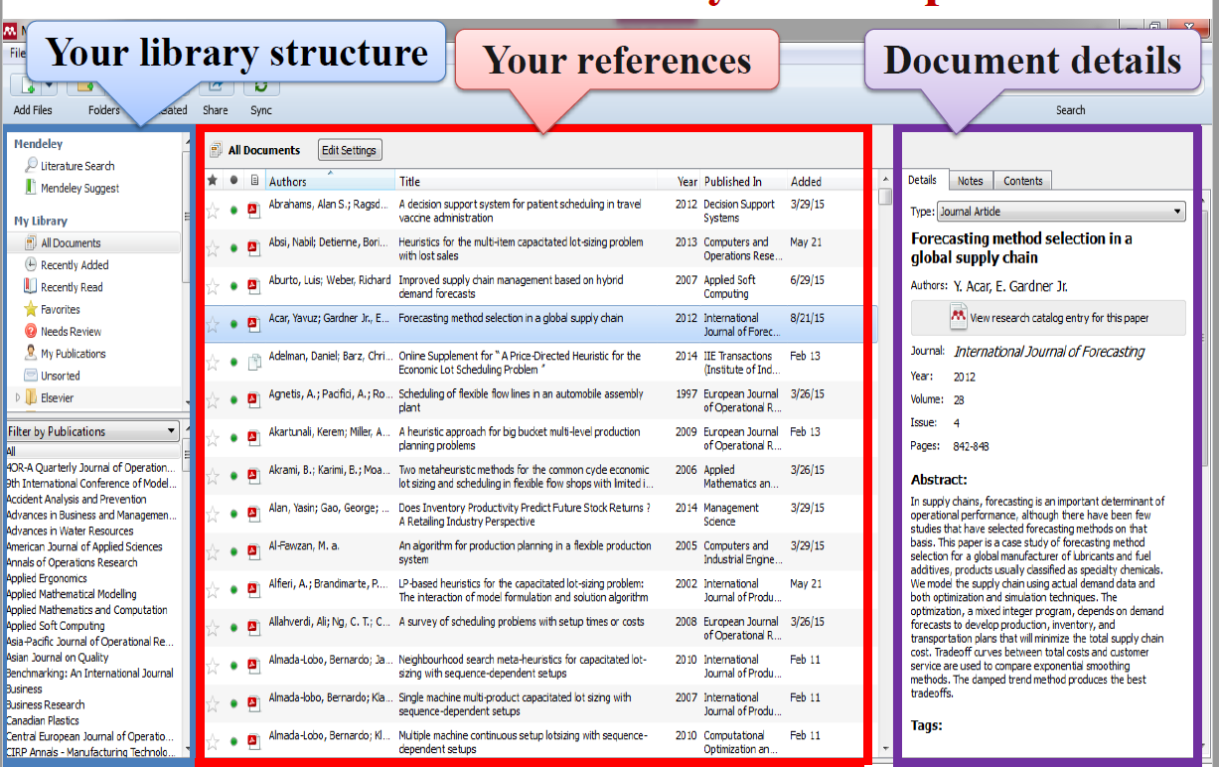

Slide 15
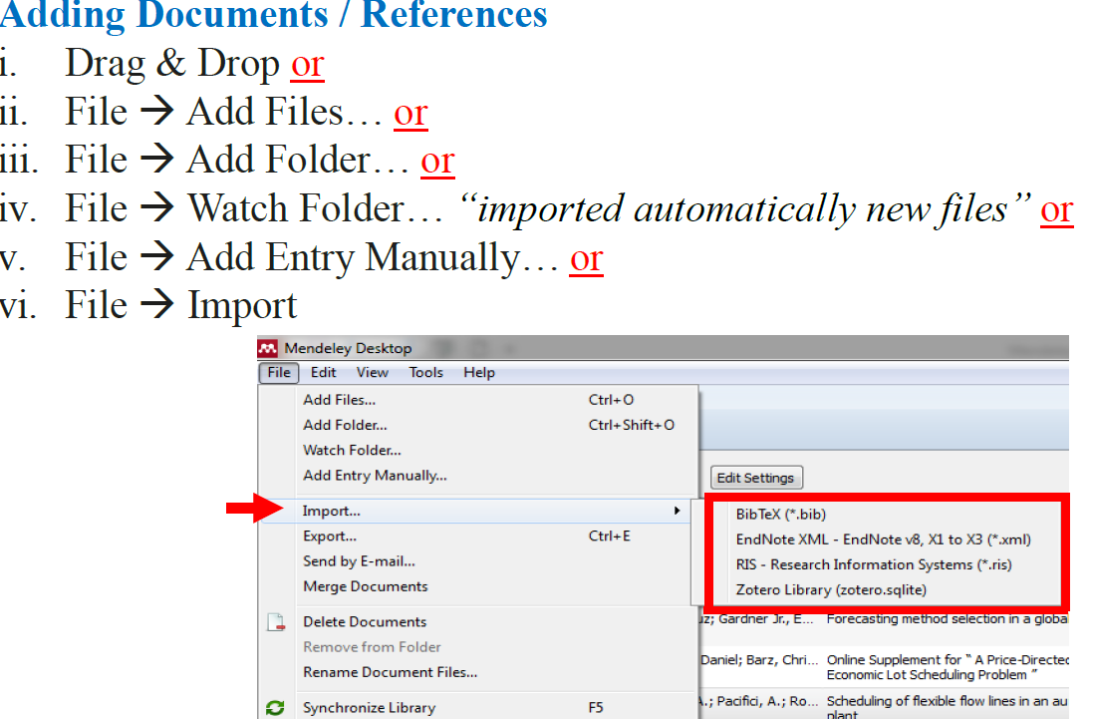

Slide 16
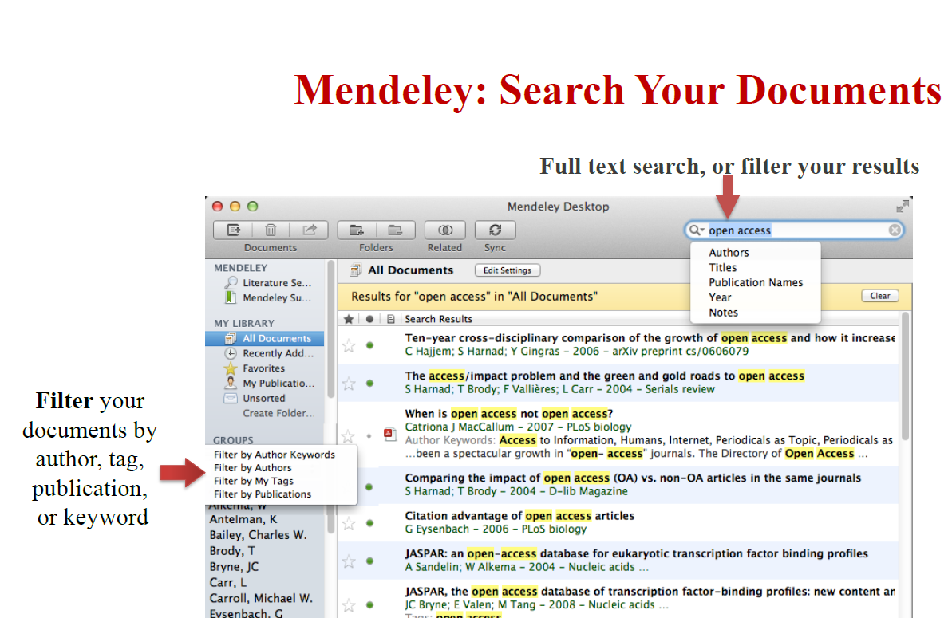

Slide 17
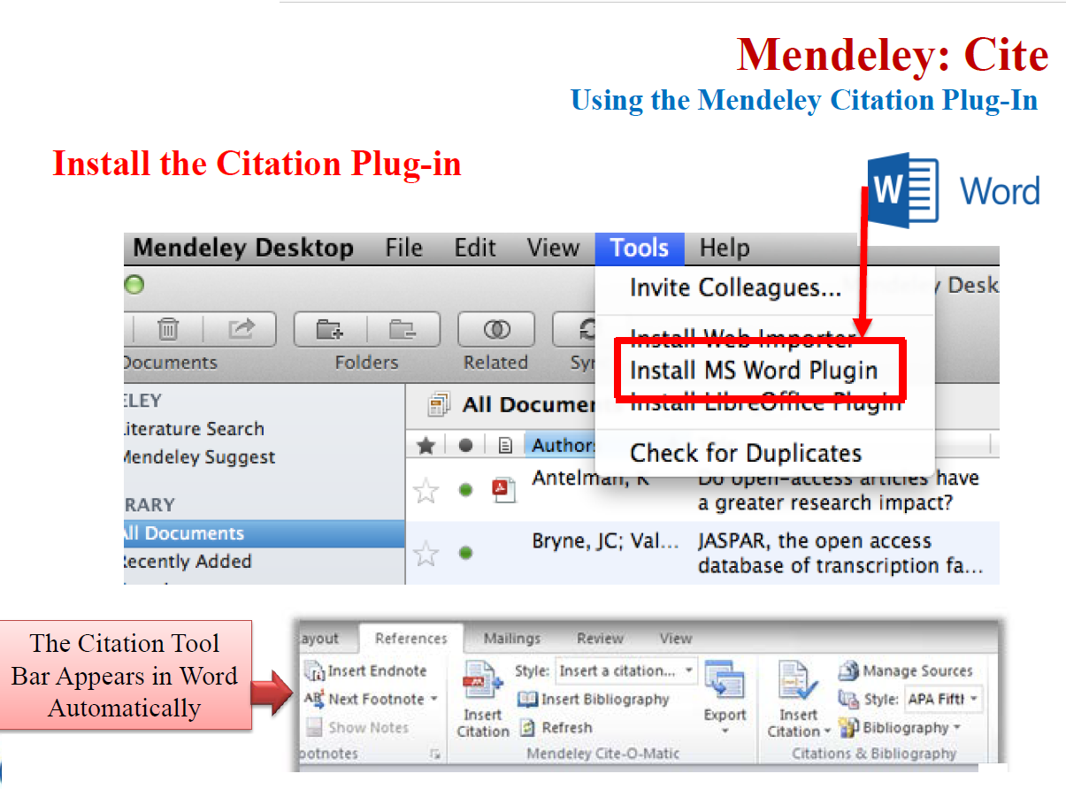

Slide 18
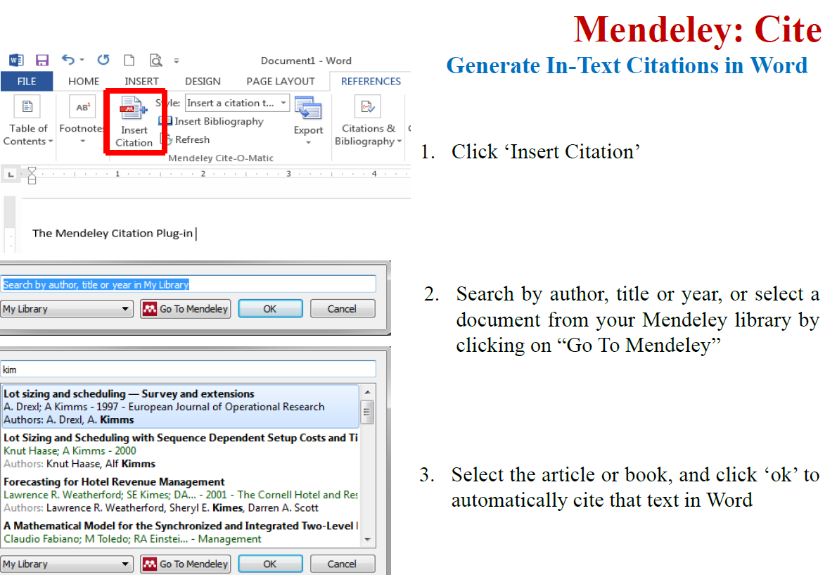

Slide 19
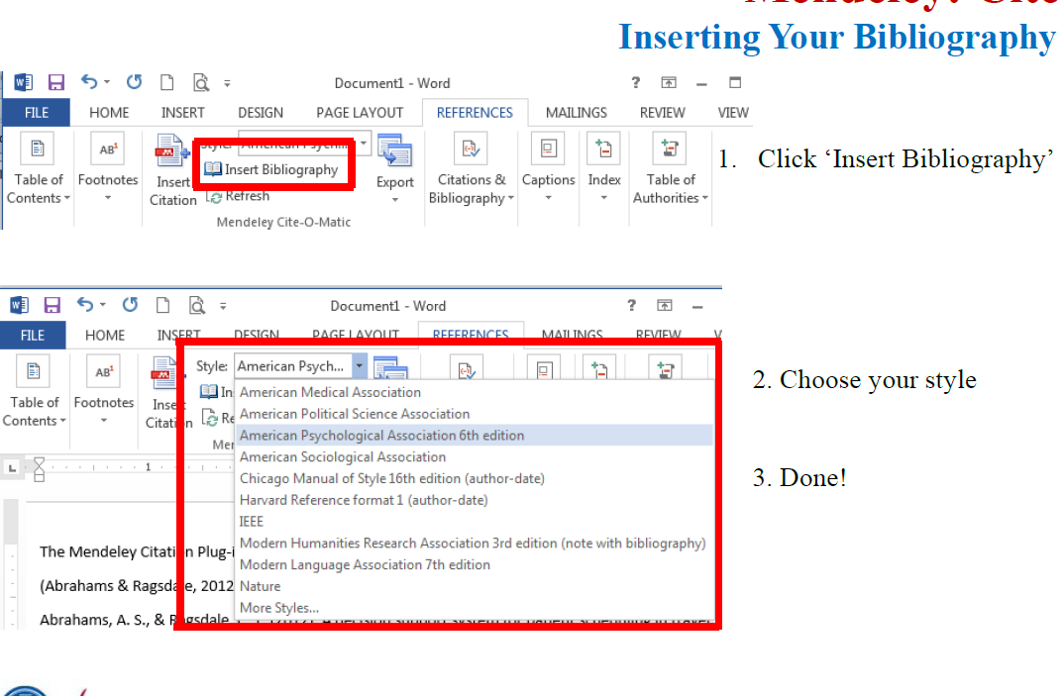

Slide 20
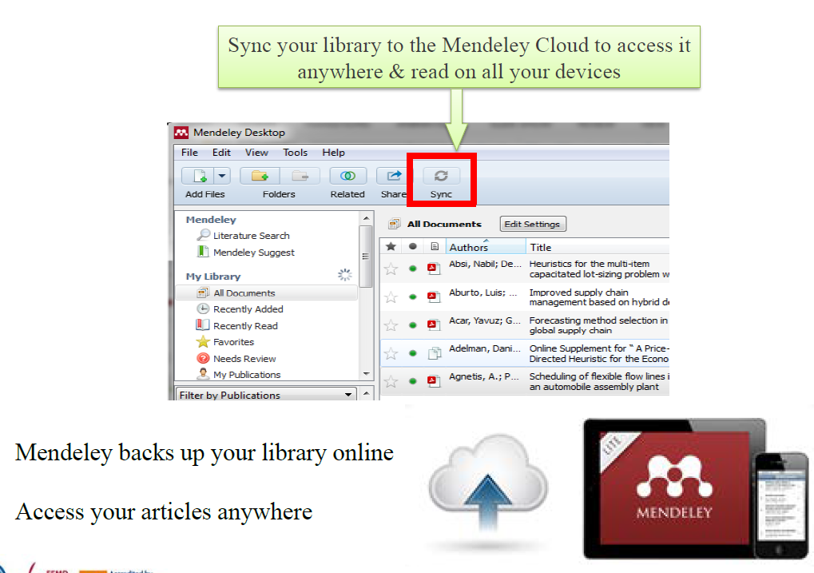

Slide 21
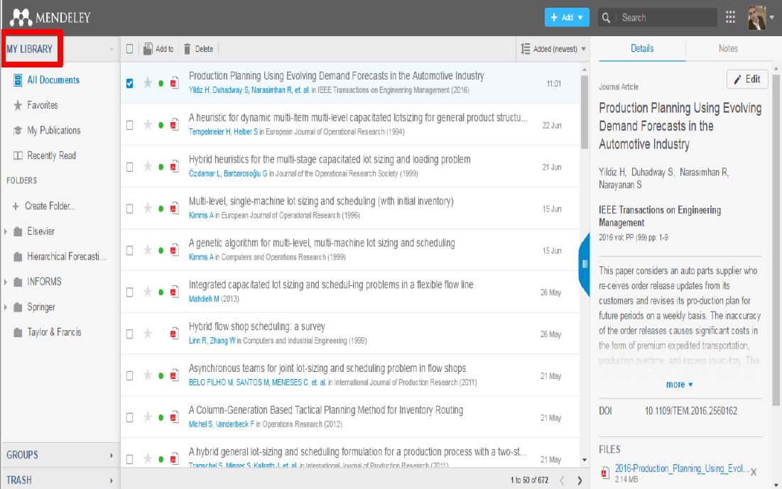

Slide 22
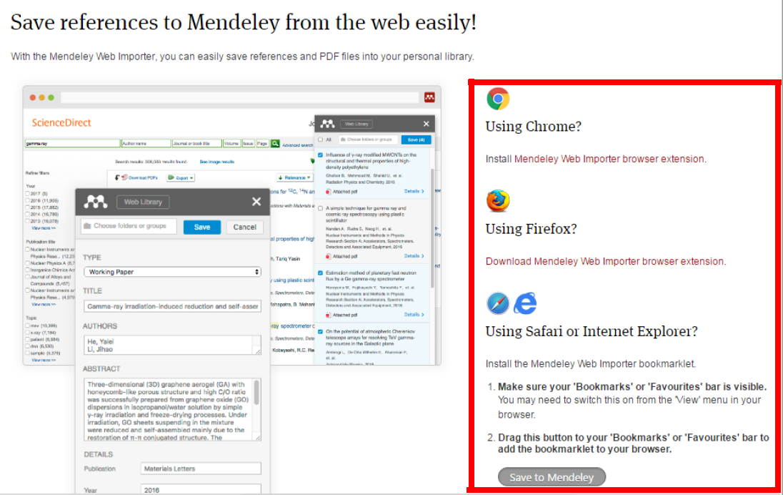

Slide 23
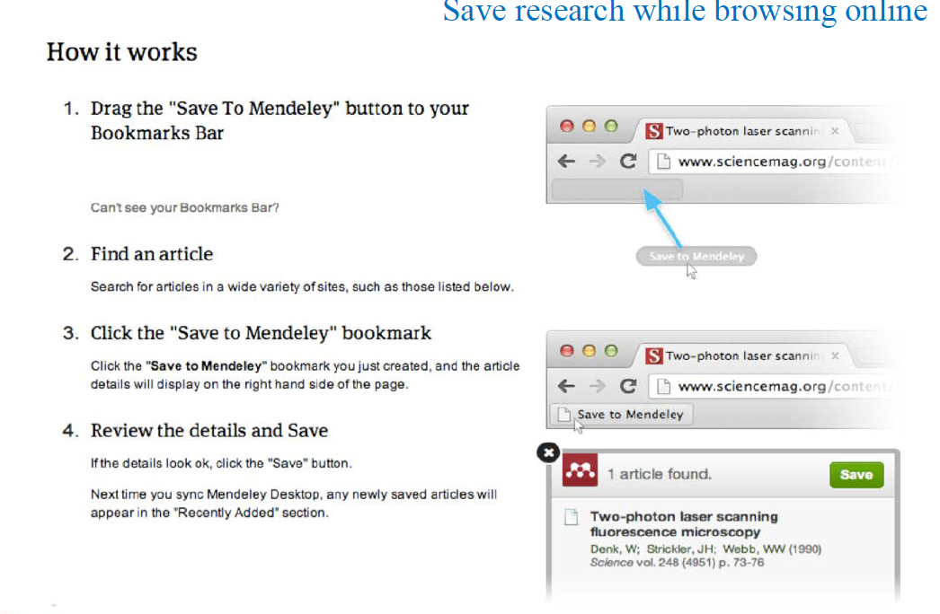

Slide 24


Slide 26
Introduction to LaTeX

Slide 27
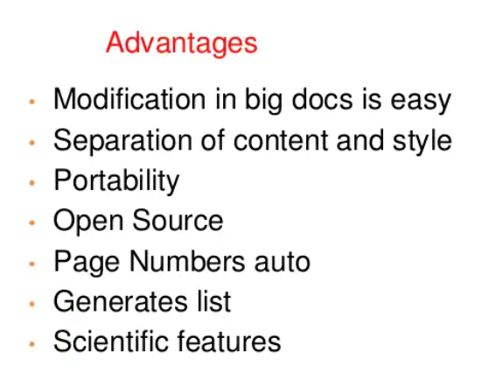
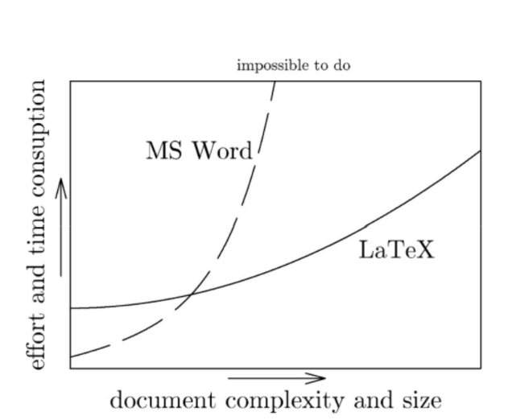
What is LaTeX?
LaTeX is pronounced “lay-tech” or “lah-tech,” not “la-teks.”
LaTeX is a document preparation system for high-quality typesetting.
LaTeX is most often used to produce technical or scientific documents, but it can be used for almost any form of publishing.

Slide 28




Why Use LaTeX?
Designed by academics and easily accommodates academic use.
Professionally crafted predefined layouts make a document really look as if “printed.”
Mathematical symbols and equations are easily integrated.
Even complex structures such as footnotes, references, table of contents, and bibliographies can be generated easily.
Forces author to focus on logical instead of aesthetic structure of a document.
Creates more beautiful documents.
Portable, compatible, flexible, versatile, and cheap (or free)!
Images from Dario Taraborelli’s Blog

Slide 29
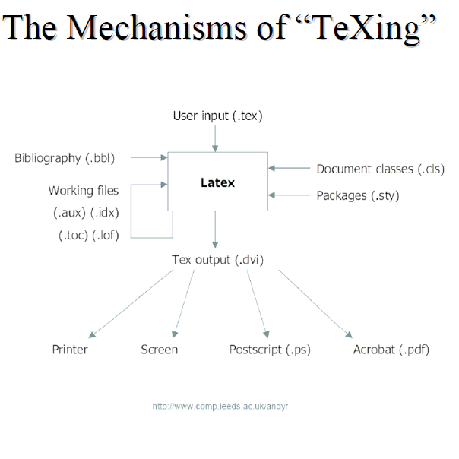

Slide 30
Installing LaTeX
In Windows
MiKTeX
MiKTeX is a typesetting system for the Windows.
Download from www.miktex.org for free
It is generally recommended to install MiKTeX first, then WinEdt.
WinEdt
WinEdt is a text editor.
WinEdt creates the source file (.tex and others).
Download from www.winedt.com for free for 30 days.
WinEdt costs $30.

Slide 31
Installing LaTeX
Other text editors
There are other text editors.
Winshell for free (http://www.winshell.de/)
Scientific Workplace
Combination of LaTeX and Mathematics program
Does a good job of calculating and graphing, very user friendly, but expensive
In Mac
TexShop
Download for free http://www.uoregon.edu/~koch/texshop/
Includes everything!

Slide 32

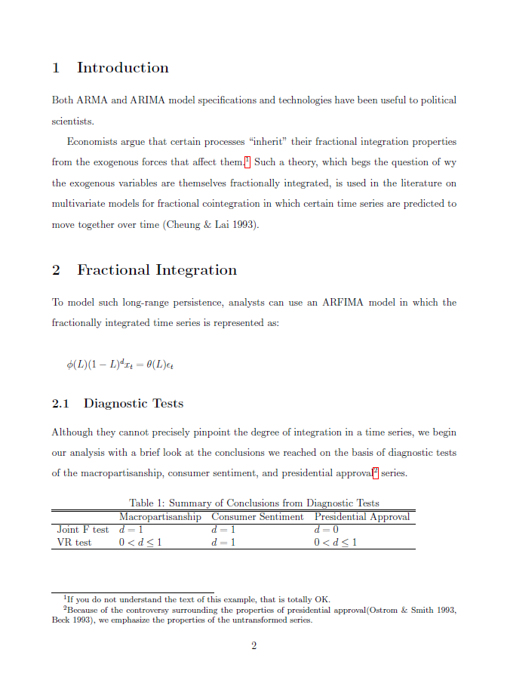

DIY

Slide 33
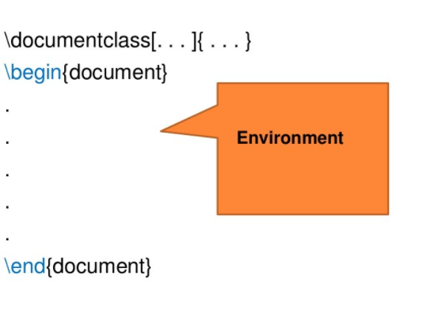
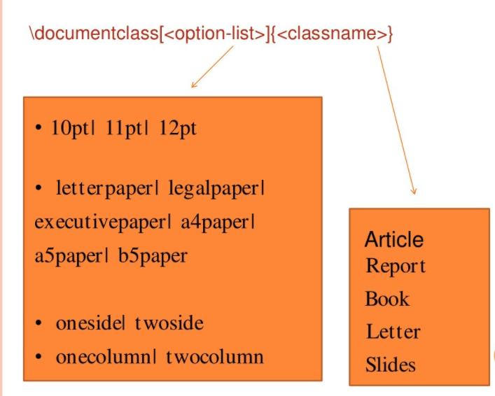

Slide 34
Basic Document Structure
The format of a document is pretty simple.
In the preamble
Documentclass
Packages
In the front matter
Title/author
In the body
Contents
In the back matter
bibliography

Slide 35
In the Preamble
You specify your document class.
Document classes: letter, article, report, book, slides(beamer, prosper)
\documentclass[12pt]{article}
Backslash – at the beginning of text markup command
Packages: numerous packages are available
\usepackage[margin=1in]{geometry}
\usepackage{setspace}
\usepackage{harvard}

Slide 36
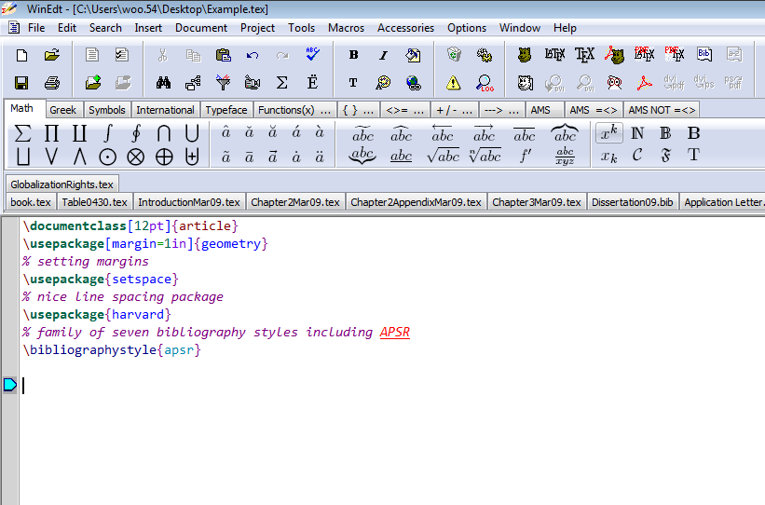

Slide 37
In the Front Matter
\begin{document}
\title{}
\author{}
\maketitle
\begin{abstract}
\end{abstract}
\pagebreak

Slide 38
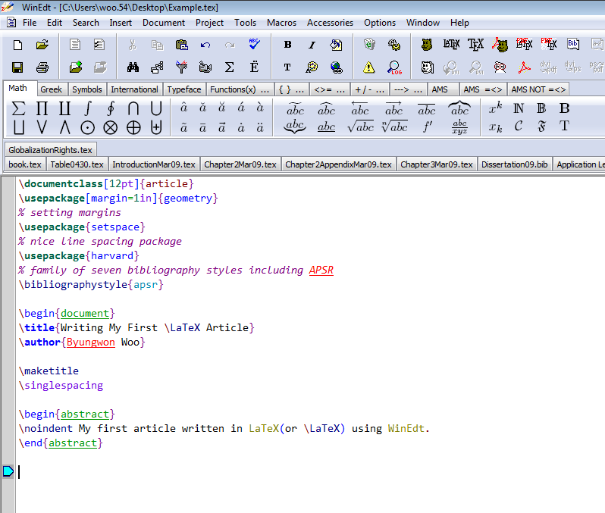

Slide 39
In the Body
To begin a new section
\section{}
Similarly, \subsection{}, \subsubsection{}, \subsubsubsection{}
LaTeX does automatic numbering. If you don’t like it, use section*{}
\emph{}, \textbf{}
\singlespacing, \doublespacing, \onehalfspacing
\centering or \begin{centering} & \end{centering}

Slide 40
Footnotes/Quotes/Equations
\footnote{}
\begin{quote} & \end{quote}
` ’, `` ’’ for quatations
Mathematical Equations
Math always in between $ & $
Alternatively, \begin{equation} & \end{equation}
$ 1+4=5 $
\frac{}{}, \sqrt{}, \sum_{k=1}^{n}
^{}, _{}
\greek letters (e.g. \alpha or \Alpha)
WinEdt also provides click and type functions.

Slide 41
Citations
\cite{bibtexkey}, citeyear{bibtexkey}
It is more convenient to create a bibliography file, called bibtex file(.bib) and use it as needed.
WinEdt is capable of creating a bib file, but there are more convenient tools out there.
JabRef (http://jabref.sourceforge.net/)

Slide 42
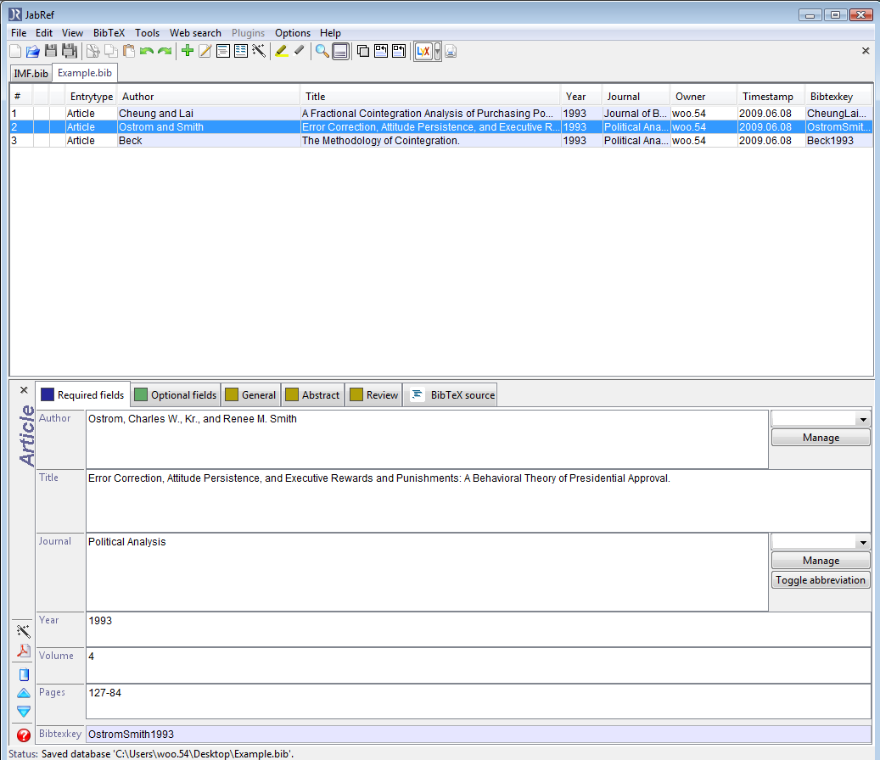

Slide 43
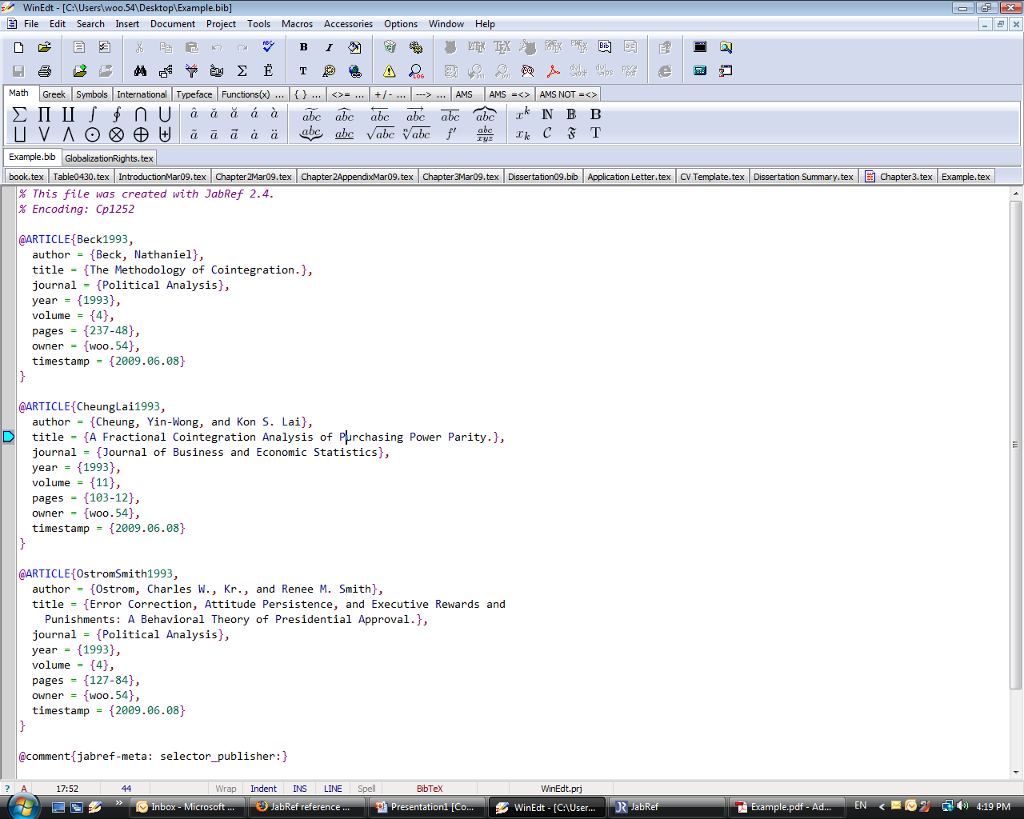

Slide 44
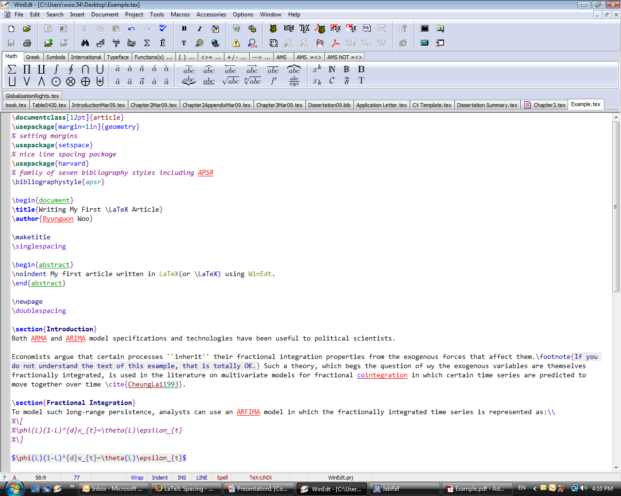

Slide 45
Creating a Table
Add numbered table
\begin{table} \caption{}
Creating a table
Simple tables can be produced by
\begin{tabular}[pos]{tablespec}
Within the {tablespec} section, one details the number of columns, the alignment, and the number of vertical lines of the table.
{lrc}, {|l|r|c}
Then type in from left to right, the values for each cell with & in between.
Put “\\” at the end of each row, then input another row of values if needed.
\hline
For STATA users, after downloading the “outtex” package online, one can simply type “outtex” after any estimation and STATA will spit out LaTeX code for the results table presented.

Slide 46
Creating a 4*3 Table
\begin{table}[h]
\caption{Summary of Conclusions from Diagnostic Tests}
\begin{tabular}{llll}
\hline
\hline
& Macropartisanship & Consumer Sentiment & Presidential Approval\\
\hline
Joint F test & $d=1$ & $d=1$ & $d=0$\\
VR test & $0<d\leq1$ & $d=1$ & $0<d\leq1$ \\
\hline
\end{tabular}
\end{table}

Slide 47
In the Back Matter
Don’t forget bibliography{filename}
Make sure that the bibtex file is saved in the same location where the main tex file is saved.
Don’t forget end{document}

Slide 48
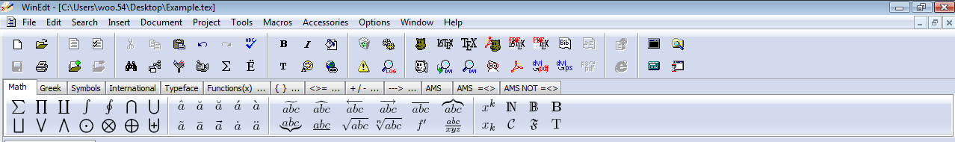
Seeing the Document
Press on the smiling bear to convert to .dvi
Press on the PDF+happy bear to convert to .pdf and open it
Press on the PDF/LaTeX to convert to .pdf

Slide 49
Common Mistakes
Often times, you make a mistake when creating a document. You will notice the log file reporting a problem.
There are some common mistakes:
“end” doesn’t follow “begin”
$ doesn’t follow $
Using commands from packages lot defined in the preamble
Don’t forget “\”s.

Slide 50
Other Resources
Books
Leslie Lampert. 1994. LaTeX: A Document Preparation System.
Helmut Kopta and Patrick W. Daly. 2004.Guide to LaTex
Frank Mittelbach et al. 2004. The LaTeX Companion
Online Guides
http://en.wikibooks.org/wiki/LaTeX
http://tobi.oetiker.ch/lshort/lshort.pdf
CV and dissertation templates are available on line

Slide 51
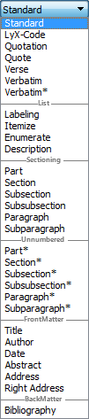
Simply click on the environment dropdown list (below menu File, has default value Standard) 只需单击“环境”下拉列表（在“文件”菜单下，具有默认值standard）

Slide 52
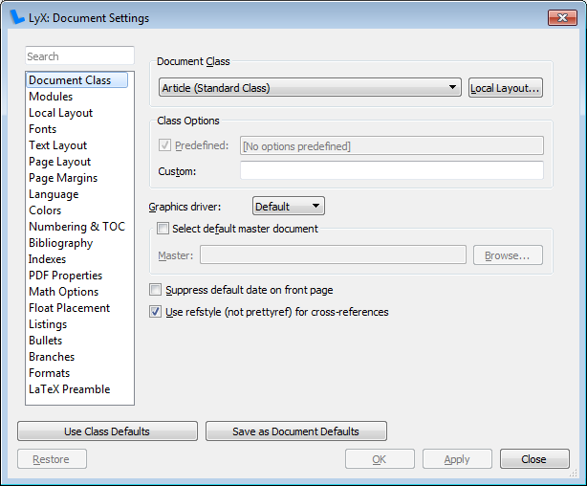
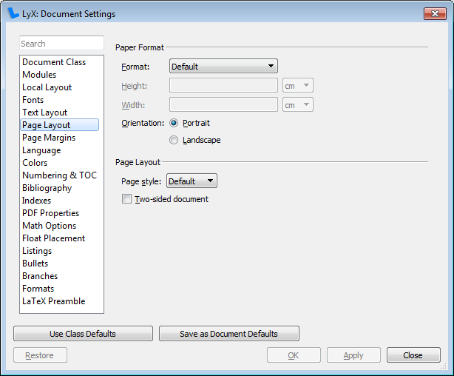
Document→Settings.

Slide 53
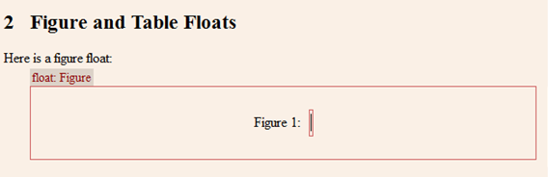
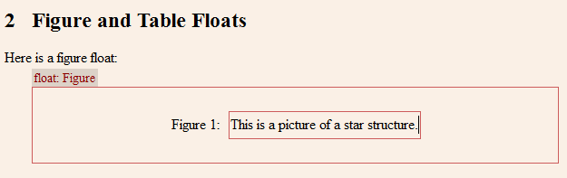
Now let's include a figure. Use the toolbar button (menu Insert→Float→Figure) 现在让我们包括一个数字。使用工具栏按钮

Slide 54
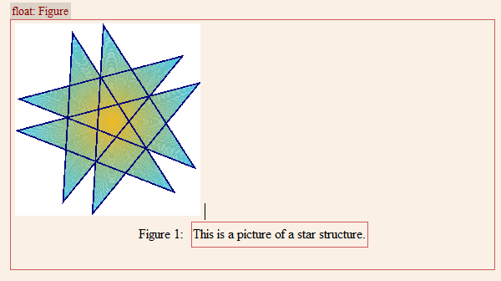
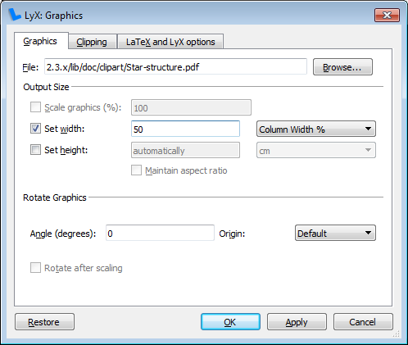
Double Click To Figure
双击图

Slide 55
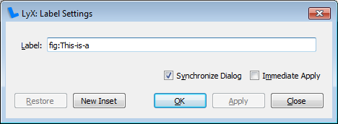
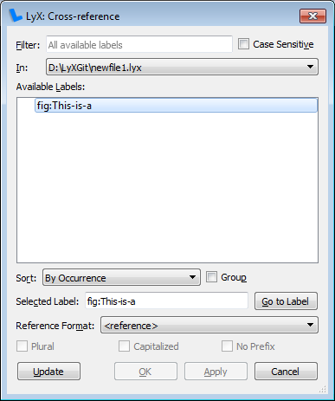
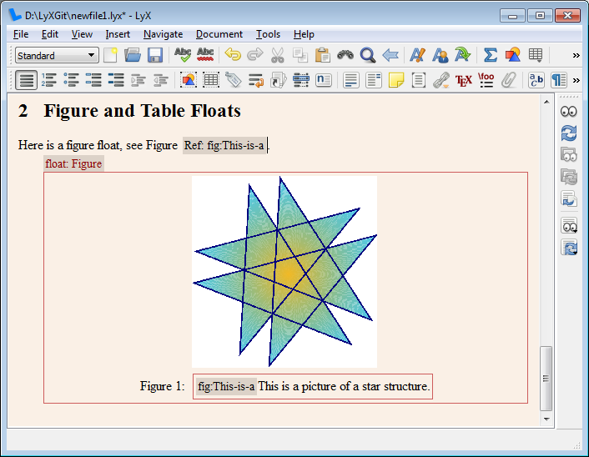
(menu Insert→Label)
Insert→Cross Reference
现在找出你想指的那个句子。 写在那里，比如“看数字”。
Now find the sentence where you want to refer to the figure. Write there something like "see Figure ".

Slide 56
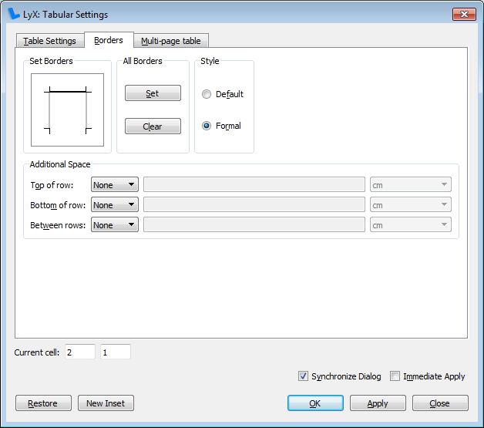
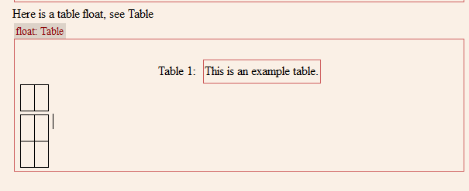
Let's now insert a table 现在我们插入一个表
right-click in the table and select Settings
在表中单击鼠标右键，然后选择“设置”

Slide 57
Math editor
Insert→Math→Inline Formula (shortcut Ctrl+m).
插入→数学→内联公式（快捷键CTRL+M）。
要获取上标，请按“^”（注意空格；下标为“u”）或工具栏按钮。这将添加一个凸起的框来通知您处于上标中。
要获取希腊字母（在本例中是小圆周率），请单击“数学”工具栏中的，然后选择圆周率。一种通常更快的方法是在公式框中键入“\pi”（注意空格）。

Slide 58

Math Editor
(menu Edit→Math→Change Formula Type→Displayed Formula). A displayed formula can also be inserted directly via the Insert menu (shortcut Shift+Ctrl+m).
也可以通过“插入”菜单（快捷键shift+ctrl+m）直接插入显示的公式。
To reference it, add a label. 要引用它，请添加标签。

Slide 59
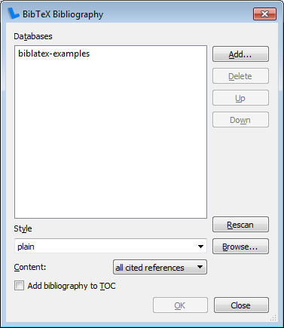
BibTEX (Bibliography)
Insert→List/TOC→Bib(la)TeX Bibliography.
In the dialog you can add several BibTeX databases and specify a style how the citations will be printed.
在对话框中，您可以添加几个bibtex数据库，并指定如何打印引文的样式。
Now you can add a citation with the toolbar button 现在可以使用工具栏按钮添加引文 (menu Insert→Citation).

Slide 60
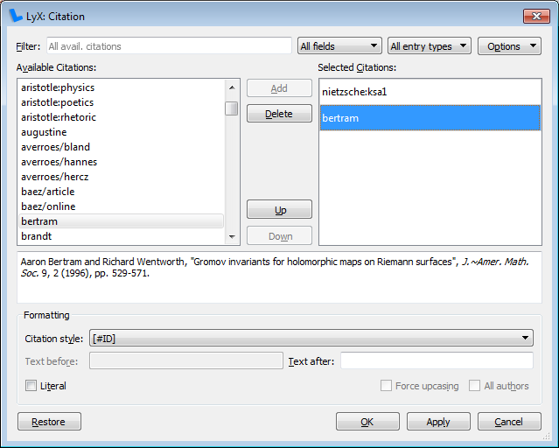

Slide 61
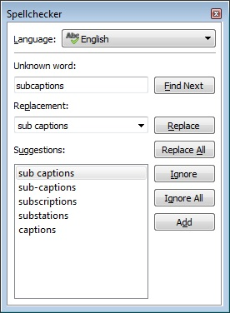
LyX allows of course to spell check documents

Slide 62
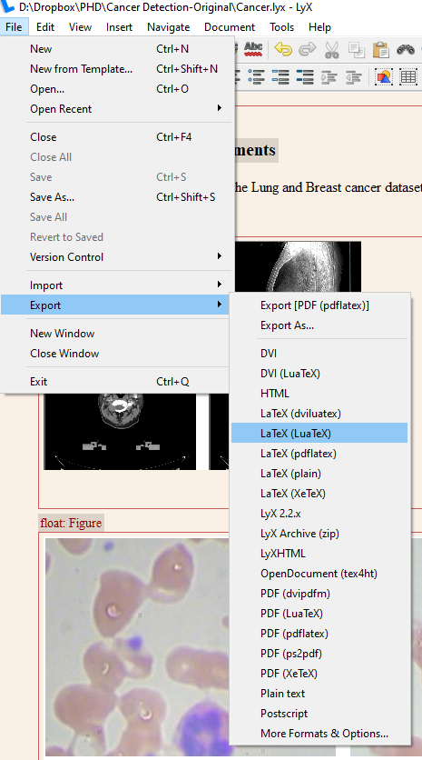
EXPORT OPTIONS (Export into Latex Source Code)

Slide 63
Add Table In Once Column in Double Column Format
\begin{table*}
\label{Hybrid Analysis Methods}
\caption{Hybrid Analysis Methods}
\end{table*}
A | B
123 | 123
555 | 444
66677
777 | 7777

Slide 64

Add Figure In Once Column in Double Column Format
\begin{figure*}
\centering
\caption{Integration of Android platform and apps with IoT devices to realize IoT dreams}
\label{fig:IoT-devices-Connected}
\end{figure*}

Slide 65
Algorithm Write in Latex

Slide 66


